Slide 1

The gruesome battle of
By Jack Crane and Danny Bohmer

Slide 2
Start Date
The battle of Okinawa began April 1, 1945

Slide 3
End Date
And ended on June 22, 1945

Slide 4
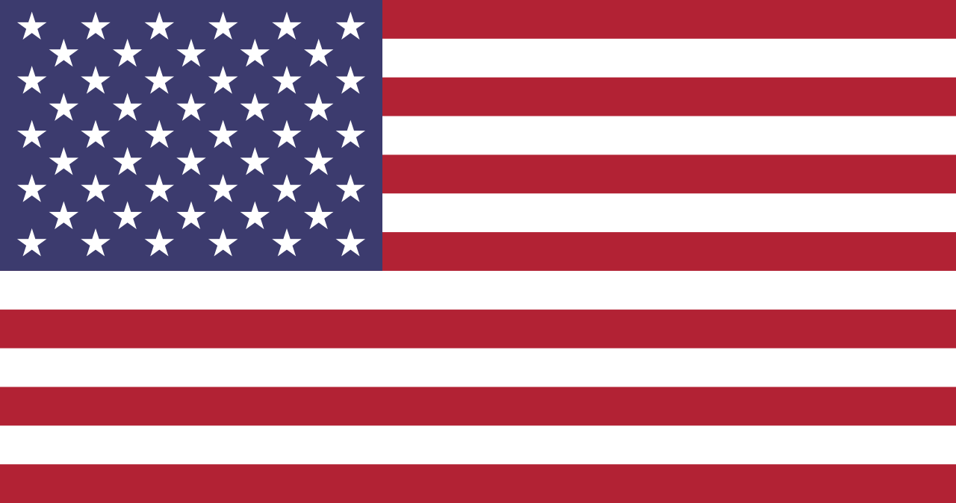
Military Leaders- America
Simon Bolivar Buckner Jr.- died
Joseph Stilwell
Roy Geiger
Claudius Miller Easley- died
Chester W. Nimitz
Raymond A. Spruance
William Halsey Jr.
https://en.wikipedia.org/wiki/Flag_of_the_United_States

Slide 5
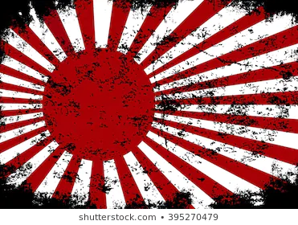
Military Leaders- Japan
Mitsuru Ushijima- died
Isamu Chō- died
Minoru Ōta- died
Seiichi Itō- died
Hiromichi Yahara- (POW)
https://www.shutterstock.com/search/wwii+battleship?image_type=illustration

Slide 6
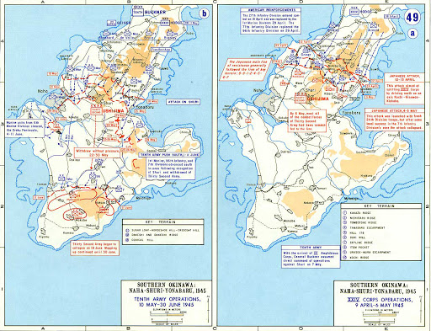
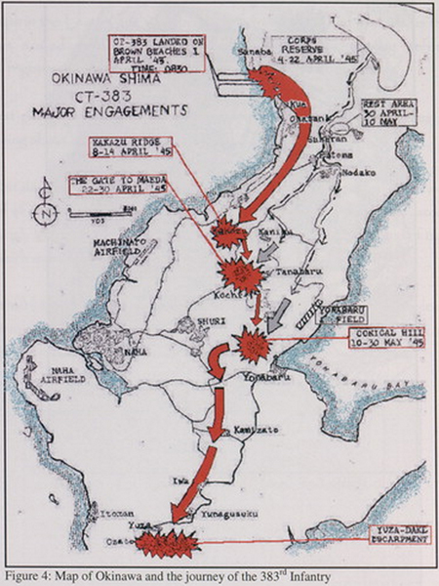
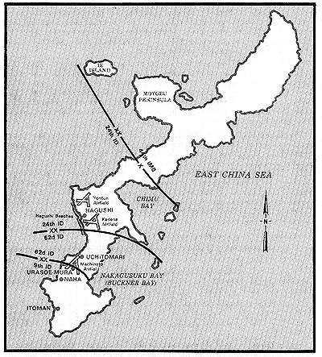
Battle Maps
http://www.emersonkent.com/map_archive/okinawa_june_1945.htm
http://www.ibiblio.org/hyperwar/USA/CSI/CSI-Okinawa/
https://primarysourcenexus.org/2012/06/today-in-history-defeat-okinawa/

Slide 7
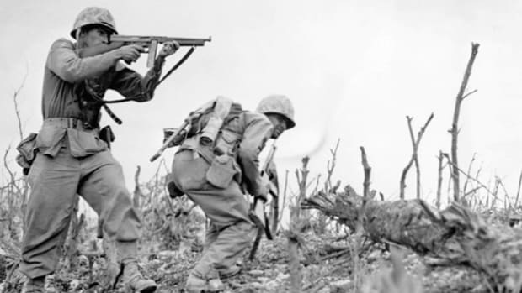
Troop Strength
American- about 103,000
Japanese- about 155,000
https://www.history.com/topics/world-war-ii/battle-of-okinawa

Slide 8


Casualties
The battle at Okinawa was the largest amphibious campaign in the pacific in WWII. The largest recorded number of ship-based weapons were fired.
38,000 Wounded; 12,000 Killed or MIA
107,000 Killed or wounded
100,000 civilians killed or wounded

Slide 9
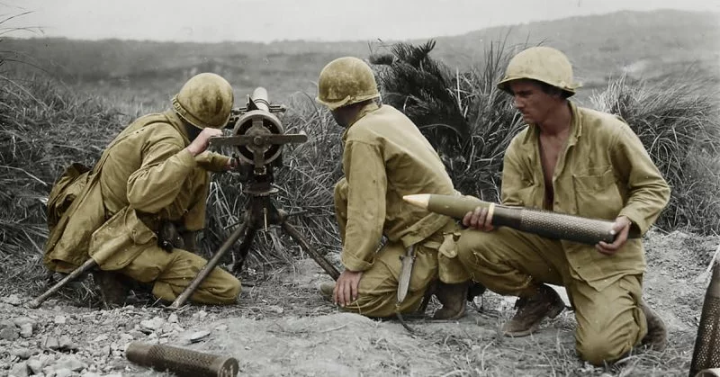
Results
The allied forces came away victorious, having pummeled the island with 30,000 shells from battleships and flame-throwing tanks.
Allied forces killed nearly 2 for every one they lost
https://www.warhistoryonline.com/instant-articles/the-battle-of-okinawa.html

Slide 10
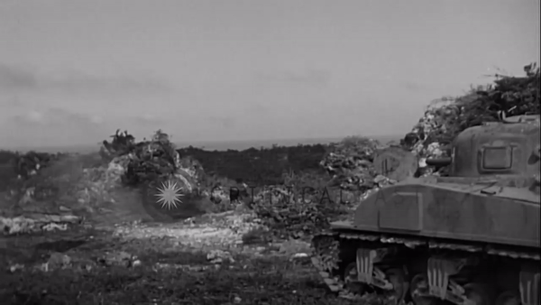

Slide 11
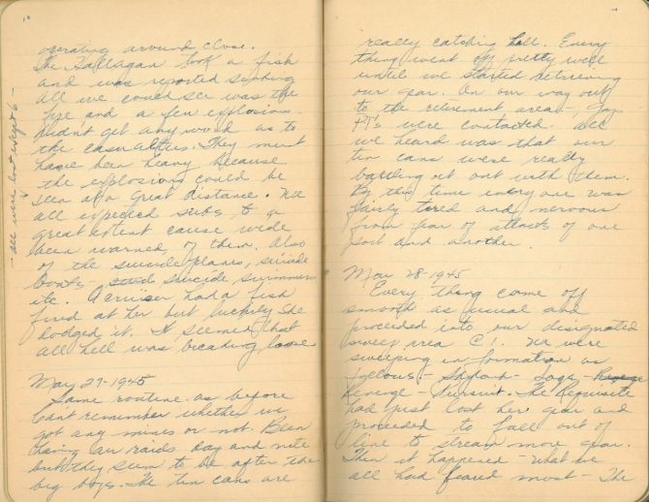
Journal Entry
Donald W. Panek (US Navy) describes his fears while approaching and on station at Okinawa - suicide planes and boats, shells, and mines

Slide 12
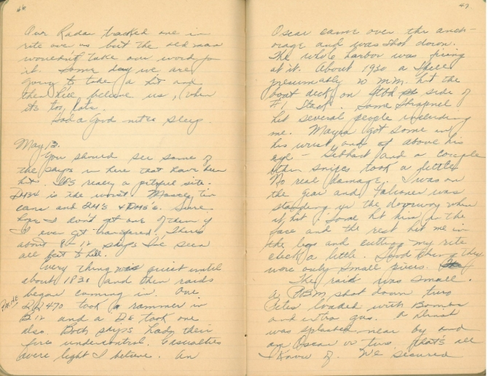
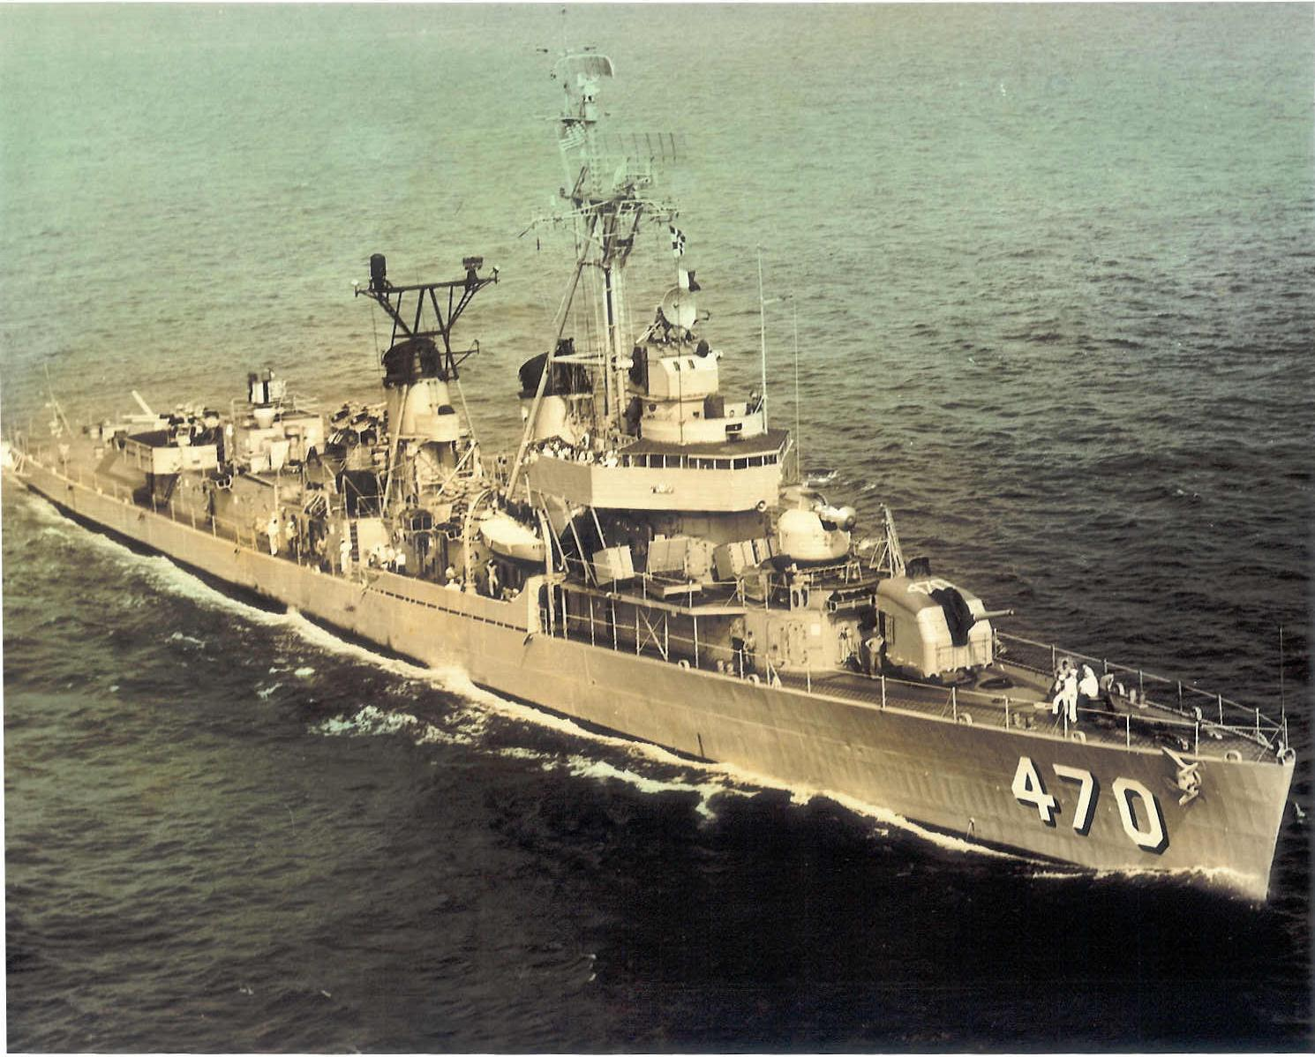
Journal Entry 2
Panek describes when 2 american ships were hit (no fatalities, ships were repaired within a few days), but the whole harbor unloaded at a japanese plane and 2 ships

Slide 13
Outcome of the battle
This was the final major battle of WWII, and it was one of the biggest wins for the Allied forces, specifically America. While still being outnumbered, America pulled through to win the last battle to take over all of Japan’s islands, which some say directly led to the dropping of the Atom Bombs on Japanese mainland.

Slide 14
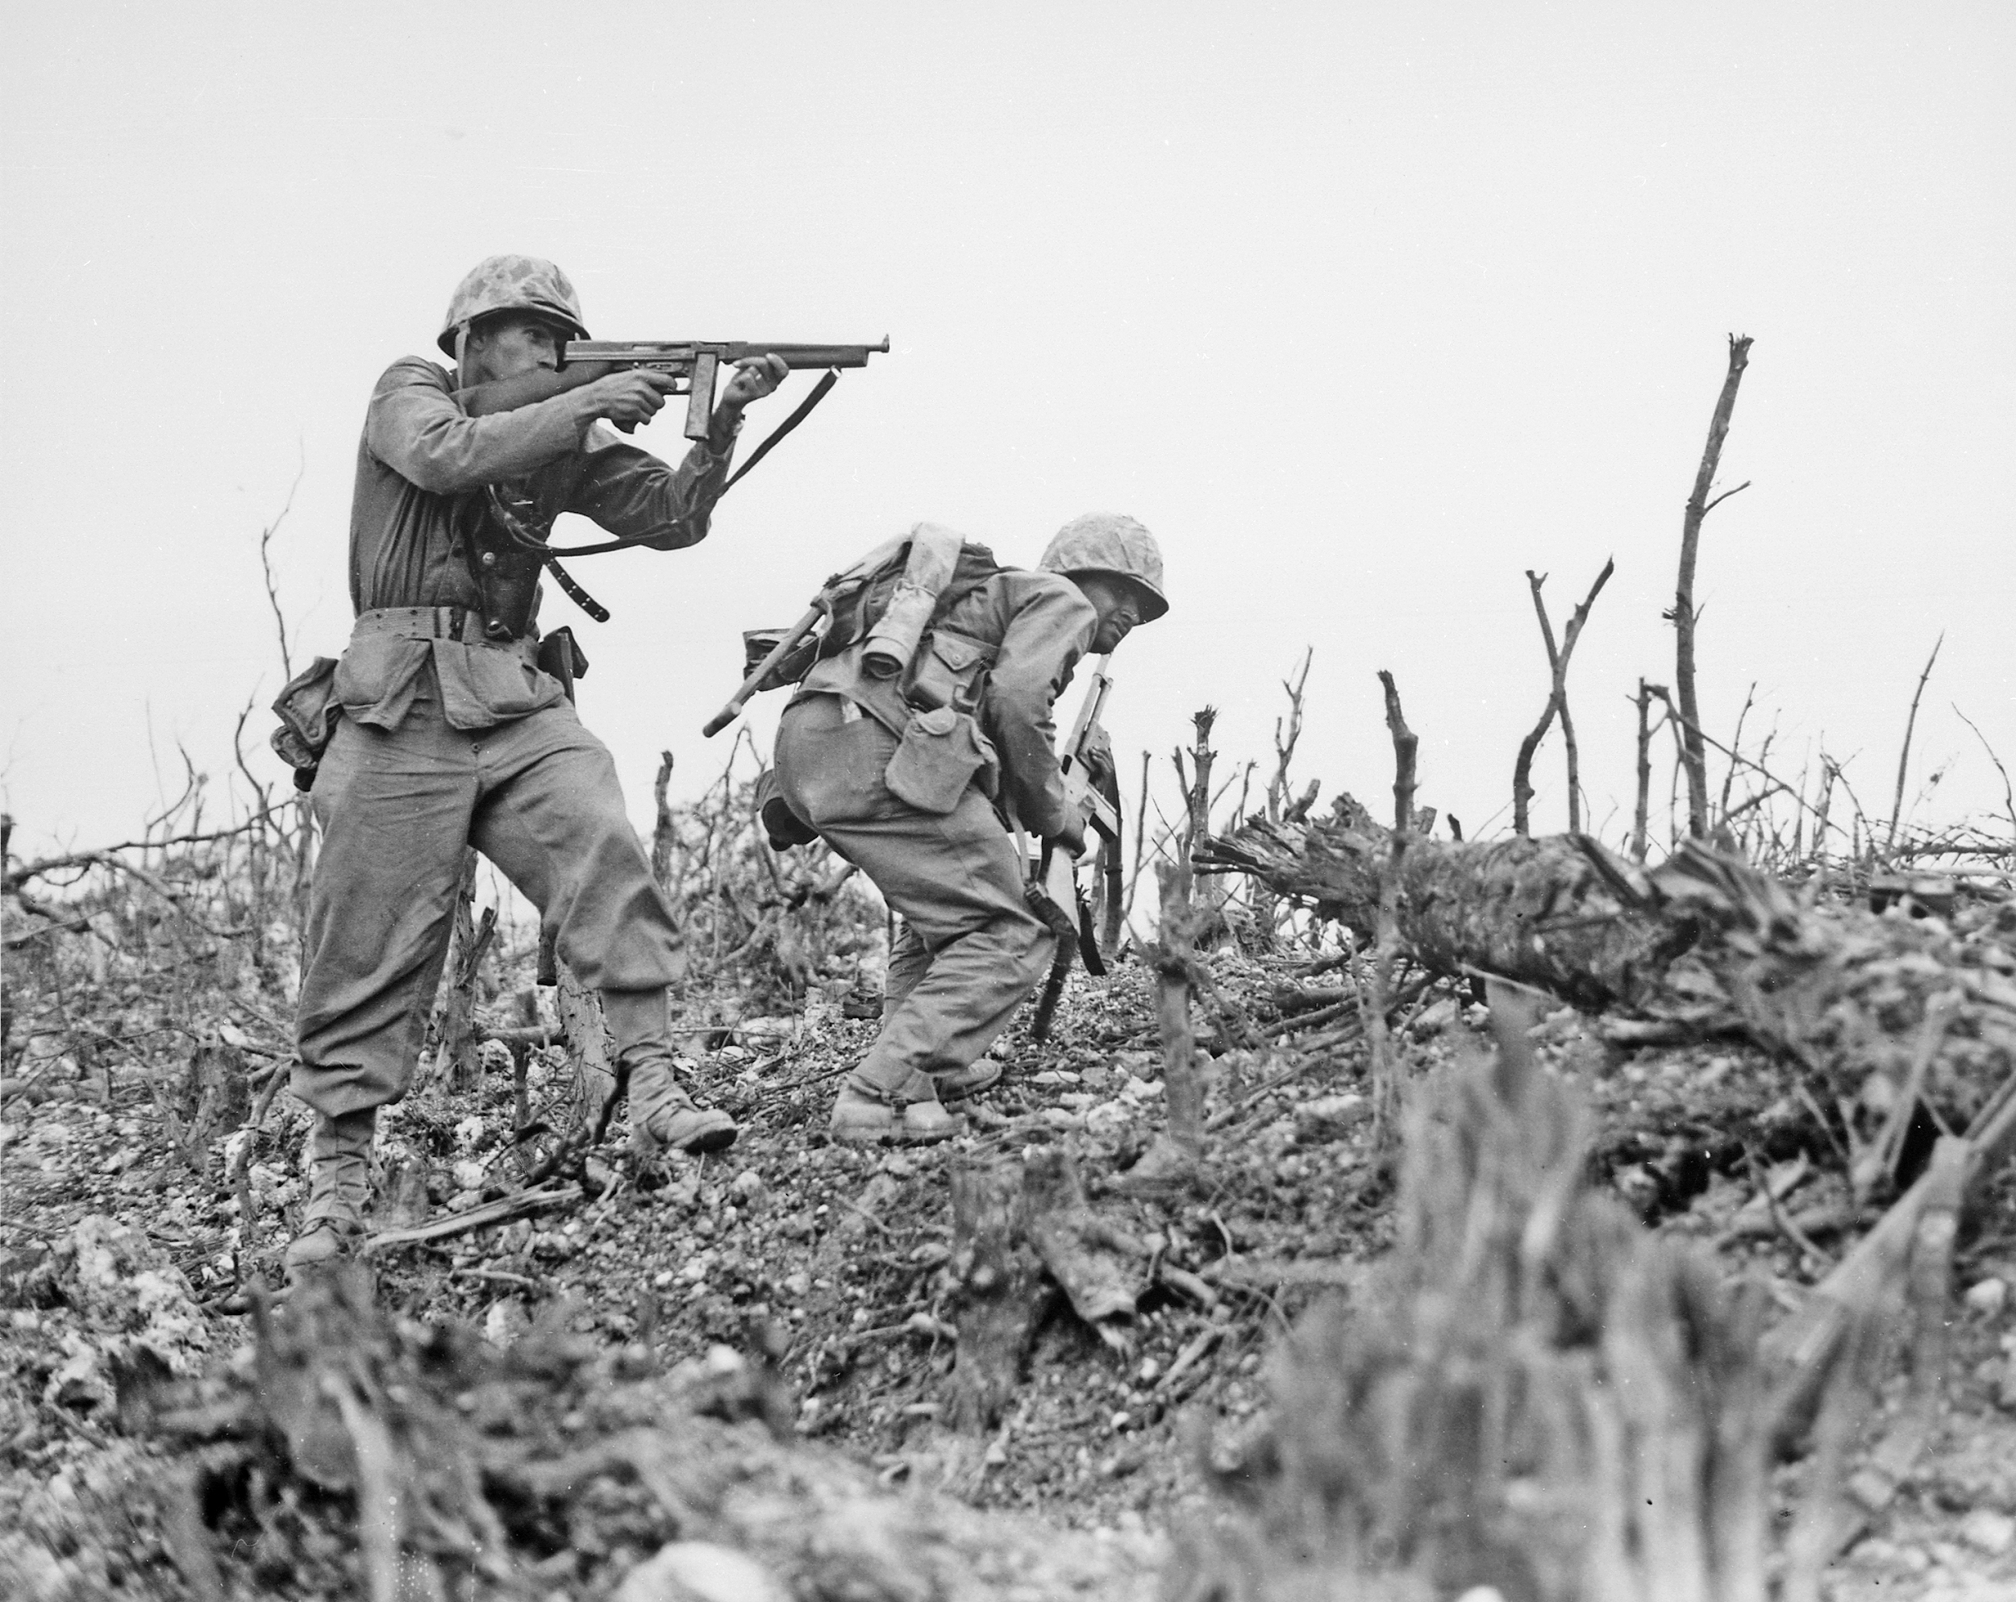
Pictures
Wikipedia

Slide 15
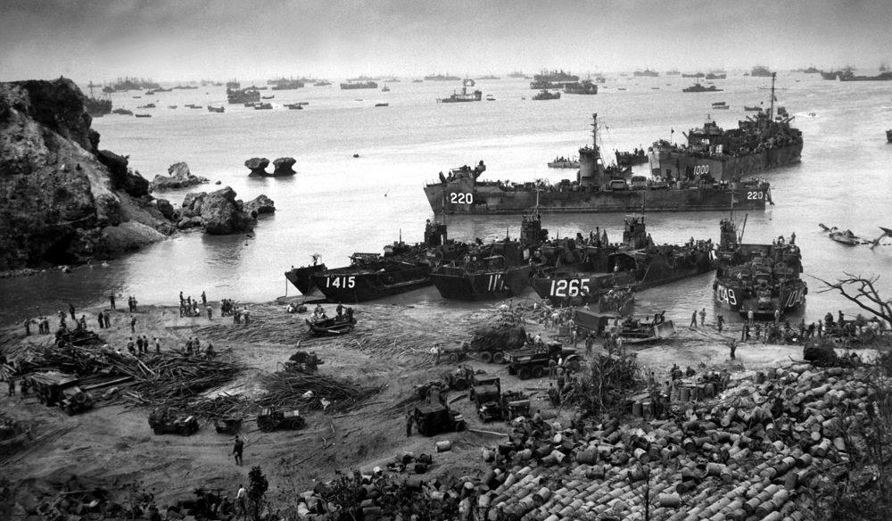
Okinawa Then
World Atlas

Slide 16
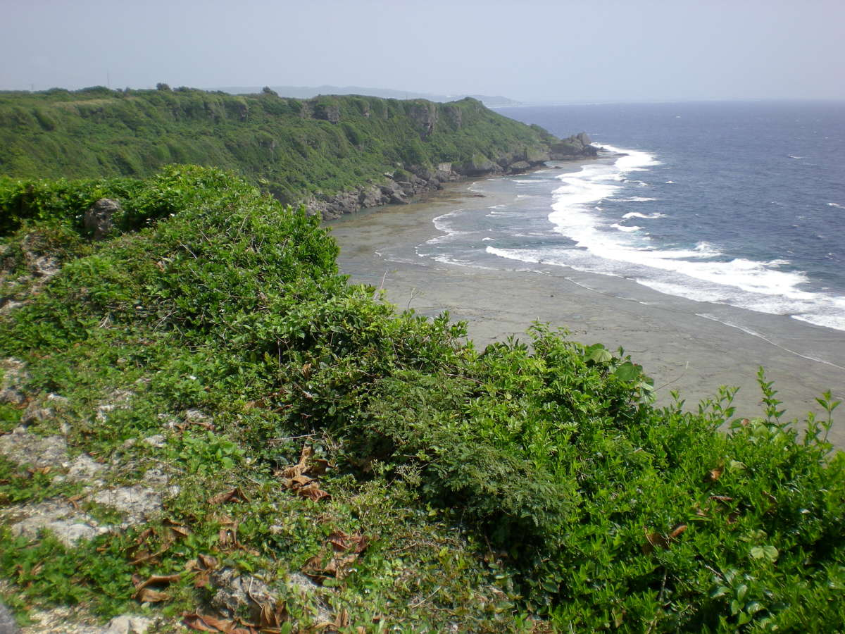
Okinawa Now
History.com

Slide 17
Sources
https://www.globalsecurity.org/military/facility/okinawa-battle.htm
https://www.historynet.com/battle-of-okinawa-operation-iceberg.htm
https://www.youtube.com/watch?v=3SMqm0HFSfc
https://www.history.navy.mil/research/library/manuscripts/p-r/donald-w-panek-wwii-diary-invasion-of-okinawa.html
https://www.history.com/topics/world-war-ii/battle-of-okinawa
https://en.wikipedia.org/wiki/Battle_of_Okinawa

